Slide 1











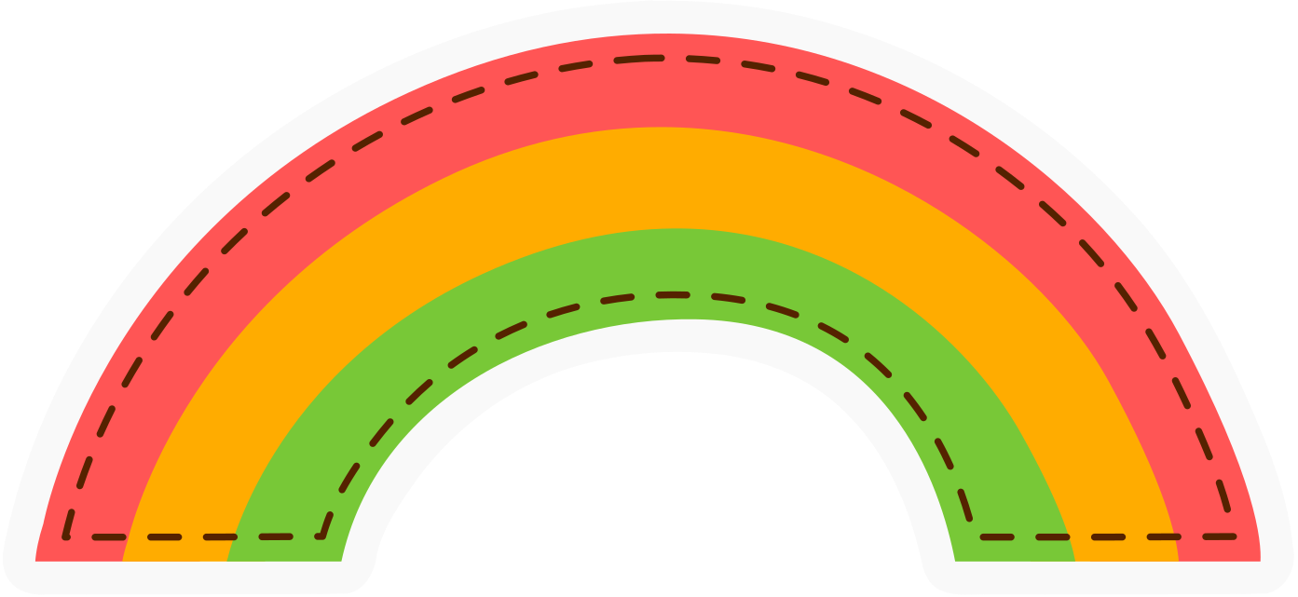
Icebreaker Game
TWO TRUTHS AND ONE LIE
TWO TRUTHS AND ONE LIE
Teacher edition!

Slide 2






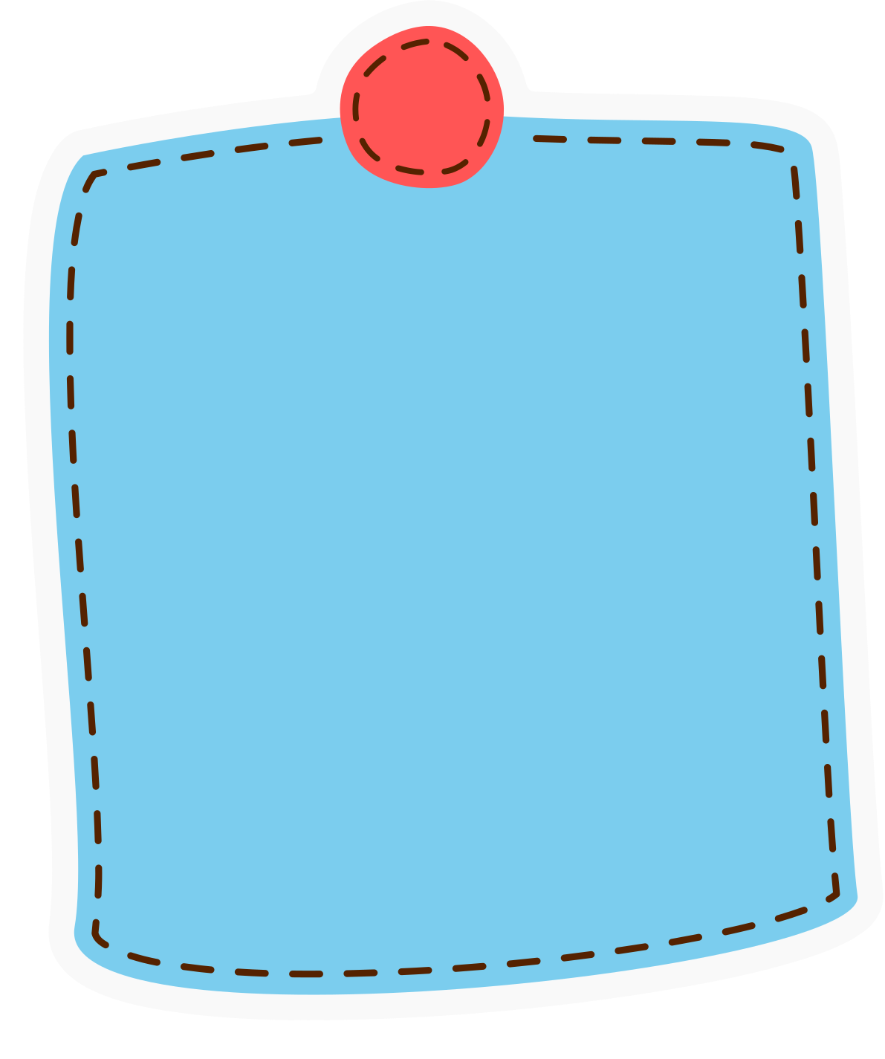
ARE YOU
READY?
ARE YOU
READY?

Slide 3
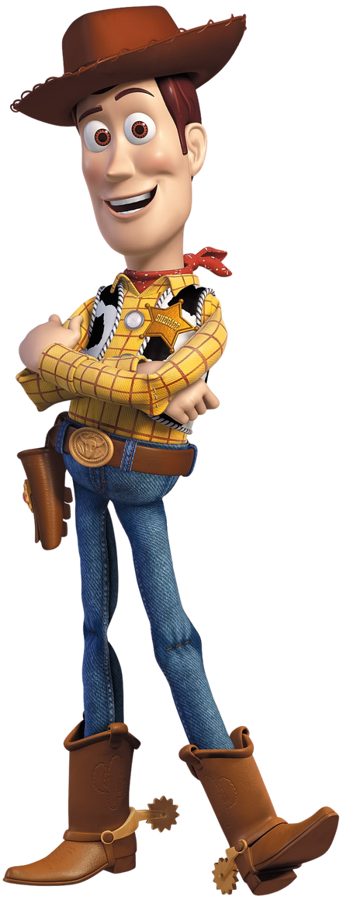

WOODY
1
1
He has a cowboy hat.
2
2
He wears a yellow shirt.
3
3
He wears pink shoes.

Slide 4


WOODY
1
1
He has a cowboy hat.
2
2
He wears a yellow shirt.
3
3
He wears pink shoes.

Slide 5
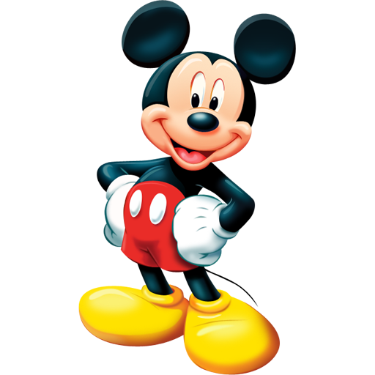
1
1
He has big round ears.
2
2
He wears blue shoes.
3
3
He wears red shorts.
MICKEY MOUSE

Slide 6
1
1
He has big round ears.
2
2
He wears blue shoes.
3
3
He wears red shorts.
MICKEY MOUSE

Slide 7
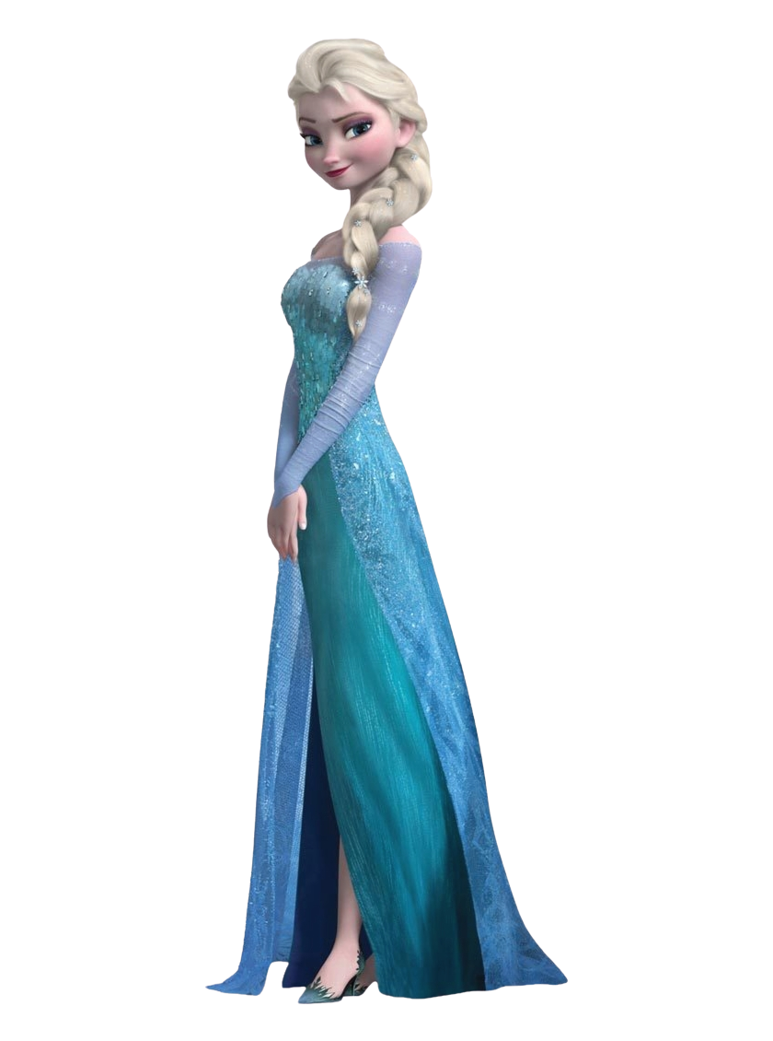
1
1
She wears black boots.
ELSA
2
2
She wears a blue dress.
3
3
She has blonde hair.

Slide 8
1
1
She wears black boots.
ELSA
2
2
She wears a blue dress.
3
3
She has blonde hair.

Slide 9
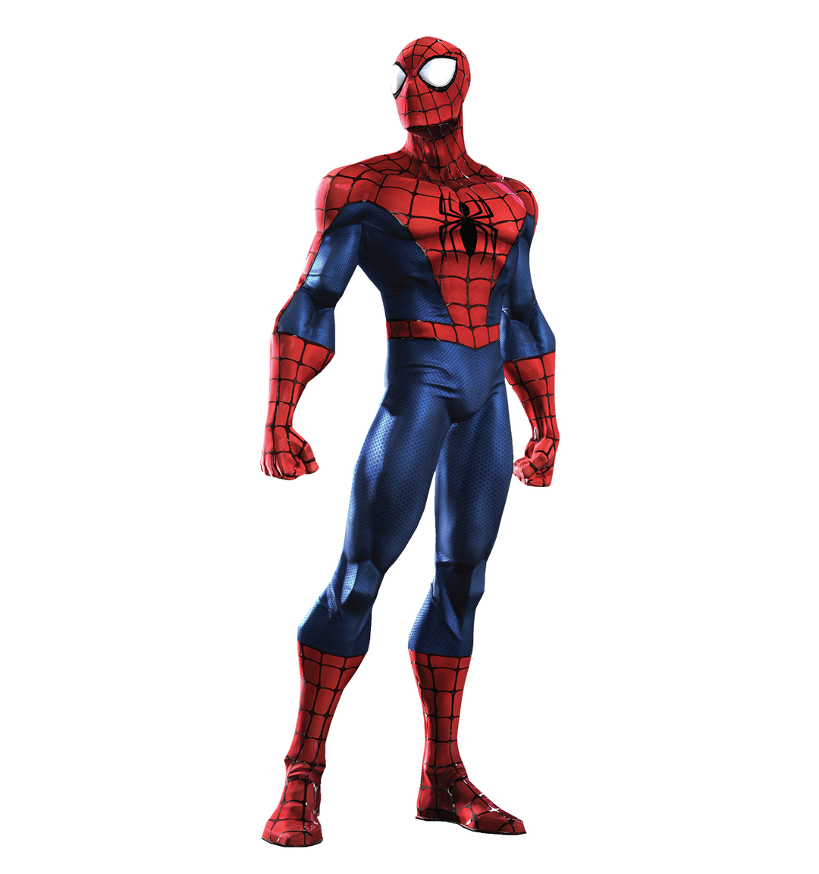
1
1
He has big eyes.
2
2
  He wears a red and blue suit.
3
3
He wears a black hat.
SPIDER-MAN

Slide 10
1
1
He has big eyes.
2
2
  He wears a red and blue suit.
3
3
He wears a black hat.
SPIDER-MAN

Slide 11
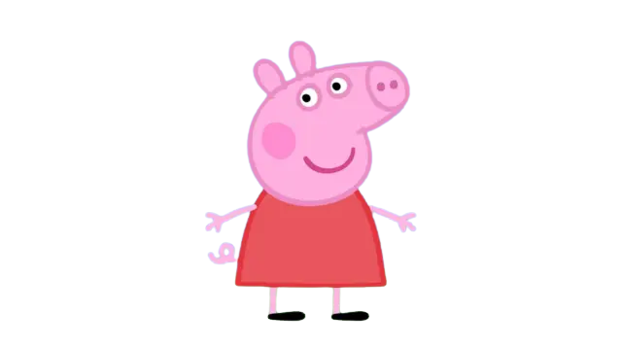
1
1
She wears black boots.
2
2
She has a pink body.
3
3
She wears a red dress.
PEPPA PIG

Slide 12
1
1
She wears black boots.
2
2
She has a pink body.
3
3
She wears a red dress.
PEPPA PIG

Slide 13
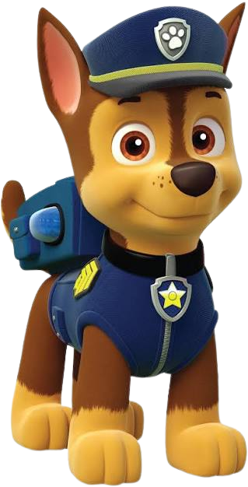
1
1
He wears a pink bow.
CHASE
2
2
He wears a blue uniform.
3
3
He has brown fur.

Slide 14
1
1
He wears a pink bow.
CHASE
2
2
He wears a blue uniform.
3
3
He has brown fur.

Slide 15
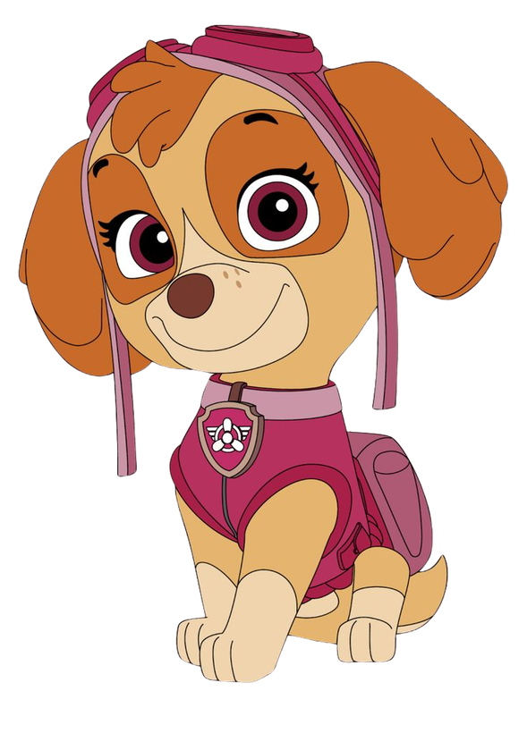
1
1
She has brown ears.
SKYE
2
2
She wears pink clothes.
3
3
She wears black boots.

Slide 16
1
1
She has brown ears.
SKYE
2
2
She wears pink clothes.
3
3
She wears black boots.

Slide 17
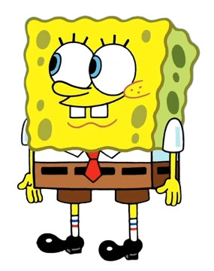
1
1
He has a yellow body.
2
2
He wears a white shirt.
3
3
He wears blue pants.
SPONGEBOB

Slide 18
1
1
He has a yellow body.
2
2
He wears a white shirt.
3
3
He wears blue pants.
SPONGEBOB

Slide 19
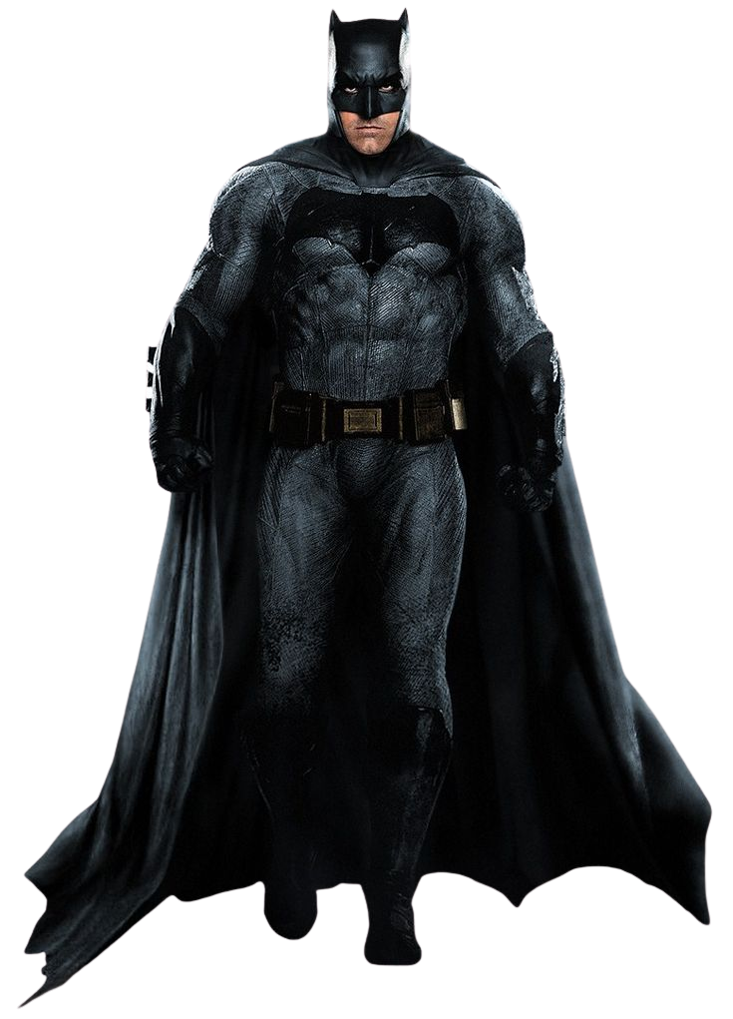
1
1
He wears a black cape.
2
2
He wears yellow sneakers.
3
3
He wears a mask.
BATMAN

Slide 20
1
1
He wears a black cape.
2
2
He wears yellow sneakers.
3
3
He wears a mask.
BATMAN

Slide 21
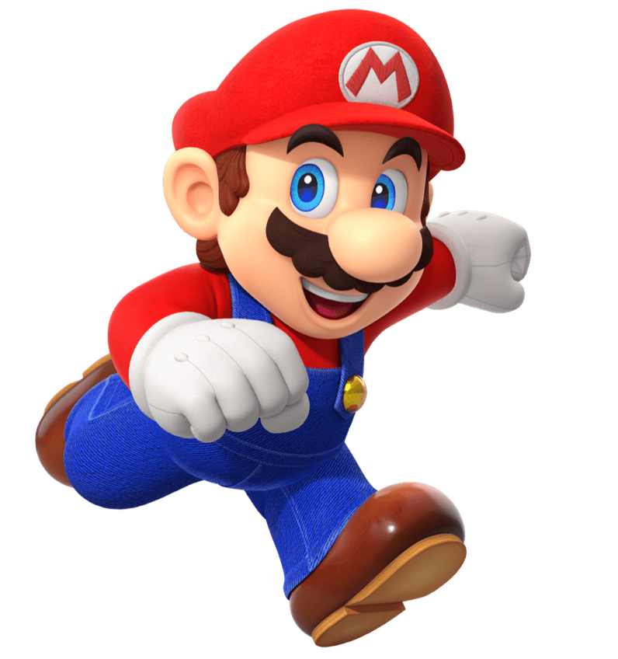
1
1
He wears green shoes.
2
2
He wears blue overalls.
3
3
He wears green shoes.
MARIO

Slide 22
1
1
He wears green shoes.
2
2
He wears blue overalls.
3
3
He wears green shoes.
MARIO

Slide 23

1
1
She has red hair.
2
2
She wears yellow shoes.
3
3
She has a green tail.
ARIEL

Slide 24
1
1
She has red hair.
2
2
She wears yellow shoes.
3
3
She has a green tail.
ARIEL

Slide 25
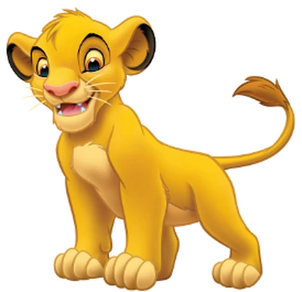
1
1
He has big ears.
2
2
He has brown fur.
3
3
He wears a blue hat.
SIMBA

Slide 26
1
1
He has big ears.
2
2
He has brown fur.
3
3
He wears a blue hat.
SIMBA

Slide 27
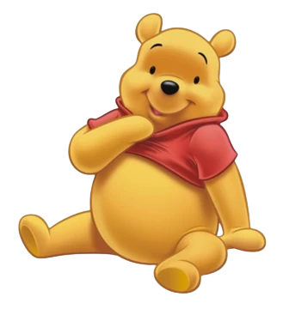
1
1
He has brown fur.
2
2
He wears a red shirt.
3
3
He wears blue pants.
WINNIE THE POOH

Slide 28
1
1
He has brown fur.
2
2
He wears a red shirt.
3
3
He wears blue pants.
WINNIE THE POOH

Slide 29
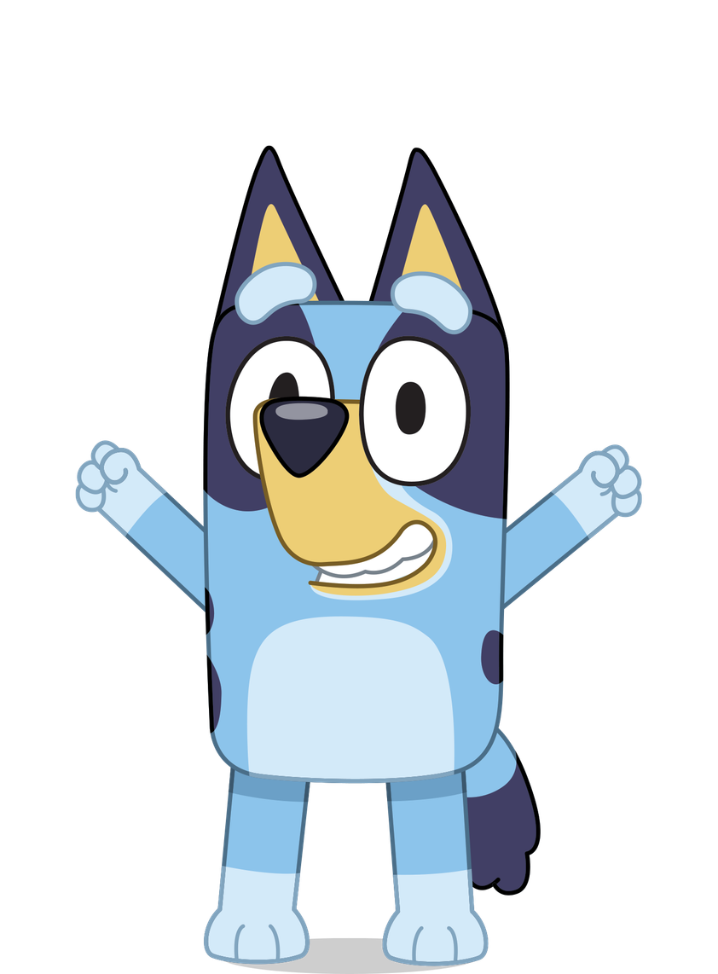
1
1
She has blue fur.
2
2
She has big ears.
3
3
She wears a purple dress.
BLUEY

Slide 30
1
1
She has blue fur.
2
2
She has big ears.
3
3
She wears a purple dress.
BLUEY

Slide 31

1
1
She has a pink bow.
2
2
She wears a dress.
3
3
She wears a blue hat.
HELLO KITTY

Slide 32
1
1
She has a pink bow.
2
2
She wears a dress.
3
3
She wears a blue hat.
HELLO KITTY

